Slide 1

Chapter 10
Error Detection
and
Correction
10.
Copyright © The McGraw-Hill Companies, Inc. Permission required for reproduction or display.

Slide 2

Note
The Hamming distance between two words is the number of differences between corresponding bits.
10.

Slide 3

Example 10.4
Let us find the Hamming distance between two pairs of words.
1. The Hamming distance d(000, 011) is 2 because
2. The Hamming distance d(10101, 11110) is 3 because
10.

Slide 4
Note
The minimum Hamming distance is the smallest Hamming distance between
all possible pairs in a set of words.
10.

Slide 5
Example 10.5
Find the minimum Hamming distance of the coding scheme in Table 10.1.
Solution
We first find all Hamming distances.
The d_{min} in this case is 2.
10.

Slide 6
Example 10.6
Find the minimum Hamming distance of the coding scheme in Table 10.2.
Solution
We first find all the Hamming distances.
The d_{min} in this case is 3.
10.

Slide 7
Note
To guarantee the detection of up to s errors in all cases, the minimum
Hamming distance in a block
code must be d_{min} = s + 1.
10.

Slide 8
Example 10.7
The minimum Hamming distance for our first code scheme (Table 10.1) is 2. This code guarantees detection of only a single error. For example, if the third codeword (101) is sent and one error occurs, the received codeword does not match any valid codeword. If two errors occur, however, the received codeword may match a valid codeword and the errors are not detected.
10.

Slide 9
Example 10.8
Our second block code scheme (Table 10.2) has d_{min} = 3. This code can detect up to two errors. Again, we see that when any of the valid codewords is sent, two errors create a codeword which is not in the table of valid codewords. The receiver cannot be fooled.
However, some combinations of three errors change a valid codeword to another valid codeword. The receiver accepts the received codeword and the errors are undetected.
10.

Slide 10
Note
To guarantee correction of up to t errors in all cases, the minimum Hamming distance in a block code
must be d_{min} = 2t + 1.
10.

Slide 11
Example 10.9
A code scheme has a Hamming distance d_{min} = 4. What is the error detection and correction capability of this scheme?
Solution
This code guarantees the detection of up to three errors
(s = 3), but it can correct up to one error. In other words,
if this code is used for error correction, part of its capability is wasted. Error correction codes need to have an odd minimum distance (3, 5, 7, . . . ).
10.

Slide 12
Note
A simple parity-check code is a
single-bit error-detecting
code in which
n = k + 1 with d_{min} = 2.
Even parity (ensures that a codeword has an even number of 1’s) and odd parity (ensures that there are an odd number of 1’s in the codeword)
10.

Slide 13
Note
All Hamming codes discussed in this book have d_{min} = 3 (2 bit error detection and single bit error correction).
A codeword consists of n bits of which k are data bits and r are check bits.
Let m = r, then we have: n = 2^{m} -1
and k = n-m
10.

Slide 14
Example 10.14
We need a dataword of at least 7 bits. Calculate values of k and n that satisfy this requirement.
Solution
We need to make k = n − m greater than or equal to 7, or 2^{m} − 1 − m ≥ 7.
1. If we set m = 3, the result is n = 2³ − 1=7 and k = 7 − 3,
or 4, which is < 7.
2. If we set m = 4, then n = 2⁴ − 1 = 15 and k = 15 − 4 =
11, which satisfies the condition k>7. So the code is
C(15, 11)
10.

Slide 15

Figure 10.15 Division in CRC encoder
10.

Slide 16

Figure 10.16 Division in the CRC decoder for two cases
10.

Slide 17
Using Polynomials
We can use a polynomial to represent a binary word.
Each bit from right to left is mapped onto a power term.
The rightmost bit represents the “0” power term. The bit next to it the “1” power term, etc.
If the bit is of value zero, the power term is deleted from the expression.

Slide 18

Figure 10.21 A polynomial to represent a binary word
10.

Slide 19

Figure 10.22 CRC division using polynomials
10.

Slide 20
Note
The divisor in a cyclic code is normally called the generator polynomial
or simply the generator.
10.

Slide 21
Note
In a cyclic code,
If s(x) ≠ 0, one or more bits is corrupted.
If s(x) = 0, either
a. No bit is corrupted. or
b. Some bits are corrupted, but the
decoder failed to detect them.
10.

Slide 22
Note
If the generator has more than one term and the coefficient of x⁰ is 1,
all single errors can be caught.
10.

Slide 23
Example 10.15
Which of the following g(x) values guarantees that a single-bit error is caught? For each case, what is the error that cannot be caught?
a. x + 1 b. x³ c. 1
Solution
a. No x^{i} can be divisible by x + 1. Any single-bit error can
be caught.
b. If i is equal to or greater than 3, x^{i} is divisible by g(x).
All single-bit errors in positions 1 to 3 are caught.
c. All values of i make x^{i} divisible by g(x). No single-bit
error can be caught. This g(x) is useless.
10.

Slide 24

Figure 10.23 Representation of two isolated single-bit errors using polynomials
10.

Slide 25
Note
If a generator cannot divide x^{t} + 1
(t between 0 and n – 1),
then all isolated double errors
can be detected.
10.

Slide 26
Example 10.16(Problem)
Find the status of the following generators related to two isolated, single-bit errors.
a. x + 1 b. x⁴ + 1 c. x⁷ + x⁶ + 1 d. x¹⁵ + x¹⁴ + 1
Solution
a. This is a very poor choice for a generator. Any two
errors next to each other cannot be detected.
b. This generator cannot detect two errors that are four
positions apart.
c. This is a good choice for this purpose.
d. This polynomial cannot divide x^{t} + 1 if t is less than
32,768. A codeword with two isolated errors up to
32,768 bits apart can be detected by this generator.
10.

Slide 27
Note
A generator that contains a factor of
x + 1 can detect all odd-numbered errors.
10.

Slide 28
Note
❏ All burst errors with L ≤ r will be
detected.
❏ All burst errors with L = r + 1 will be
detected with probability 1 – (1/2)^{r–1}.
❏ All burst errors with L > r + 1 will be
detected with probability 1 – (1/2)^{r}.
10.

Slide 29
Example 10.17
Find the suitability of the following generators in relation to burst errors of different lengths.
a. x⁶ + 1 b. x¹⁸ + x⁷ + x + 1 c. x³² + x²³ + x⁷ + 1
Solution
a. This generator can detect all burst errors with a length
less than or equal to 6 bits; 3 out of 100 burst errors
with length 7 will slip by; 16 out of 1000 burst errors of
length 8 or more will slip by.
10.

Slide 30
Example 10.17 (continued)
b. This generator can detect all burst errors with a length
less than or equal to 18 bits; 8 out of 1 million burst
errors with length 19 will slip by; 4 out of 1 million
burst errors of length 20 or more will slip by.
c. This generator can detect all burst errors with a length
less than or equal to 32 bits; 5 out of 10 billion burst
errors with length 33 will slip by; 3 out of 10 billion
burst errors of length 34 or more will slip by.
10.

Slide 31
Note
A good polynomial generator needs to have the following characteristics:
1. It should have at least two terms.
2. The coefficient of the term x⁰ should
be 1.
3. It should not divide x^{t} + 1, for t
between 2 and n − 1.
4. It should have the factor x + 1.
10.

Slide 32
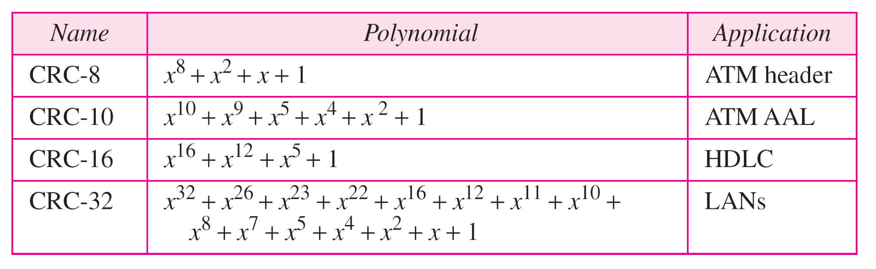
Table 10.7 Standard polynomials
10.

